Slide 1






SQL Walmart Sales Project
The influence of economic and seasonal variables on Walmart’s weekly sales.
By Miguel Santos
By FearlessS
Project Overview
Insights & Recommendations
Data Collection
Data Cleaning
Data Analysis

Slide 2






Project Overview
Project Title: The influence of economic and seasonal variables on Walmart’s weekly sales.
Objective: The study is motivated by the critical need for large retailers to optimize operational efficiency and gain strategic insight into the factors driving their weekly sales. The complexity of the retail environment means sales are highly volatile, influenced by a wide array of forces, including seasonal fluctuations, local events, and broader economic trends.
Impact Analysis: Determining how external factors (like Holiday_Flag, Temperature, Fuel_Price, CPI, Unemployment) affect Weekly Sales.
Store Performance Comparison: Identifying which stores are performing better than others.
Anomaly Detection: Finding unusual spikes or drops in weekly sales.
Scope: The analysis focuses on Walmart retail sales data between 2010-02-05 and 2012-11-01.
Methodology: This project was made using MySQL 8.0.
Significance: The significance lies in providing Walmart’s management with quantitative, evidence-based insights into how specific external and economic factors drive sales volatility, which is crucial for optimizing inventory levels, refining labor schedules, and improving strategic resource allocation across the retail network.

Slide 3






Insights
Some stores (like store 35) have very high volatility in weekly sales. This means there might be
unknown store specific factors affecting weekly sales performance worth investigating.
Some holidays do seem to influence weekly sales. Thanksgiving being the best by far with 41% increased sales on average compared to normal weeks. Christmas does influence negatively, with -8% weekly sales on average.
Fuel prices do not seem correlated to weekly sales;
Unemployment does seem to have a negative correlation with weekly sales, with 58% increased weekly sales at 4% unemployment rate compared to 14% unemployment rate;
CPI does seem to have a slightly negative correlation with average weekly sales, with sales dropping 7% on average when CPI is high;
Temperature does not seem to be correlated with weekly sales, but when temperature is very hot, sales are 15% lower on average.

Slide 4

Recommendations
Conduct Store Deep Dives:
For the top 5 most volatile stores, investigate local factors (e.g., specific dates of local events,
regional manager changes, competitor openings) that correlate with their sales peaks and troughs.
The goal is to standardize and replicate the successes while mitigating the dips.
Capitalize on the Holiday Effect:
Ensure adequate staffing, optimal inventory levels, and aggressive short-term promotions during
the weeks immediately preceding and during a holiday. Treat these periods as critical revenue drivers;
Focus on Value and Essentials:
During periods of rising national/regional Unemployment or CPI, shift marketing focus to everyday
value items and store-brand essentials to attract budget-conscious shoppers and protect market share
from discounters;
Exercise caution opening stores in very hot locations.
It’s possible consumers avoid leaving their homes unless necessary, reducing in-store visits.
Heatwaves can disrupt supply chains, particularly for fresh produce, dairy, and meat. This can lead
to less availability and fewer purchases.

Slide 5
Data Collection
Sources:
Dataset: https://github.com/zmsantos08/SQL_Walmart_Project/blob/b74a41af7c93eb70ff51e2b7e2927cf690ea32a2/Walmart_Sales.csv)
About the dataset:
This is the historical data that covers sales from 2010-02-05 to 2012-11-01, in the file Walmart_Store_sales. Within this file you will find the following fields:
Store - the store number Date - the week of sales Weekly_Sales - sales for the given store Holiday_Flag - whether the week is a special holiday week 1 – Holiday week 0 – Non-holiday week Temperature - Temperature on the day of sale Fuel_Price - Cost of fuel in the region CPI – Prevailing consumer price index Unemployment - Prevailing unemployment rate
Holiday Events: Super Bowl 12-Feb-2010 11-Feb-2011 10-Feb-2012 08-Feb-2013 Labour Day 10-Sep-2010 09-Sep-2011 07-Sep-2012 06-Sep-2013 Thanksgiving 26-Nov-2010 25-Nov-2011 23-Nov-2012 29-Nov-2013 Christmas 31-Dec-2010 30-Dec-2011 28-Dec-2012 27-Dec-2013

Slide 6
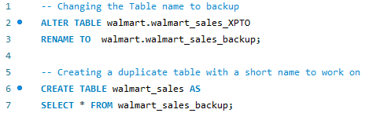
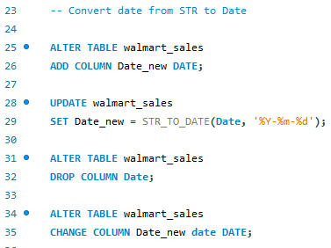
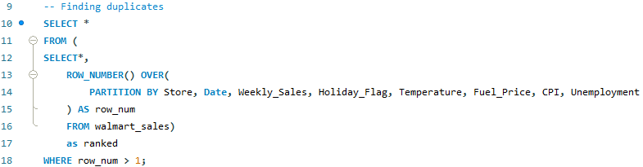
Data Cleaning
Converting the date format from String to Date.
Creating a duplicate table to preserve the original.
No Duplicates were found.

Slide 7
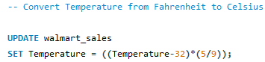
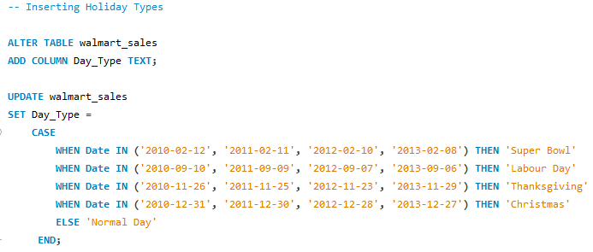
Data Cleaning
Converting Temperature from Fahrenheit to Celsius.
Inserting a column (Day_Type) with the name of the Holidays for a deeper analysis.

Slide 8
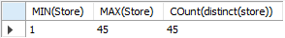
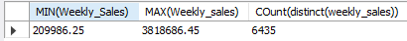
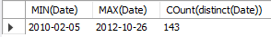
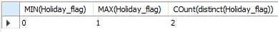
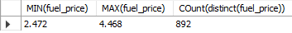
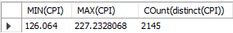
Data Cleaning
Validating data ranges to try to spot some inconsistency. All seems to make sense.
The table has 45 stores.
The table 6435 weekly entries, with a maximum of $3.818.686,45 and a minimum of $209.986,25.
The table has 143 weeks.
Holiday values are only 0 or 1.
Temperature (ºC) min -19º and max 38º.
Fuel prices ($) changed widely between
2010-02-05 and 2012-11-01.
CPI changed widely between 2010-02-05 and 2012-11-01.
Unemployment rate (%) changed widely between 2010-02-05 and 2012-11-01.

Slide 9
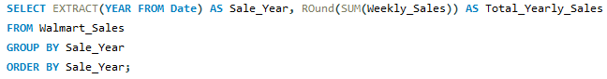
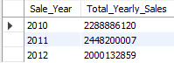
Data Analysis
Yearly Trend Analysis
Q: How have sales changed with time?
A: At first sight, it seems sales have decreased from 2010 to 2012, but let’s not forget 2010 data starts on 2010-02-05 and 2012 data ends on 2012-11-01, the only full year was 2011, which has the highest sales and makes it unreliable to make a conclusion without the missing data.

Slide 10
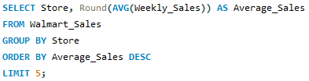
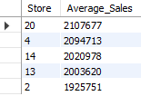
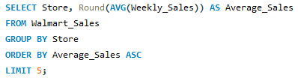
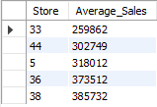
Data Analysis
Store Performance Analysis
Q: Which stores have the highest average weekly sales?
Q: Which stores have the lowest average weekly sales?

Slide 11
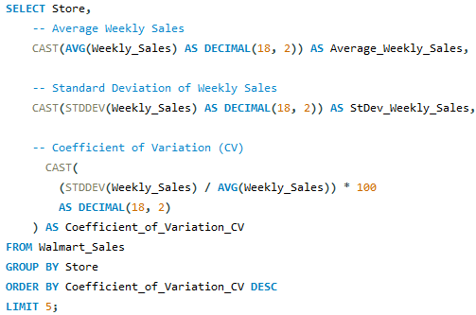
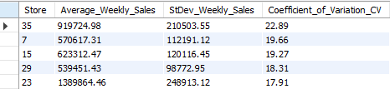
Data Analysis
Store Performance Analysis
Q: How much of a difference in average weekly sales exists between the best and worst performing stores?
A: Some stores (like store 35) have a very high Coefficient of Variation (CV).
This means there might be unknown store specific factors affecting weekly sales performance worth investigating.

Slide 12
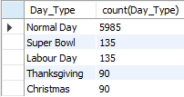
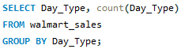
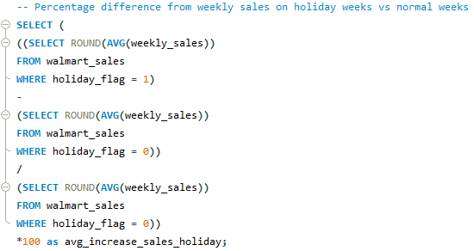
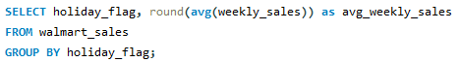
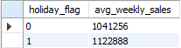
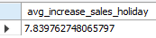
Data Analysis
Impact of Special Events (Holidays) on Weekly Sales
In our analysis, let’s not forget there is 1 (x45 stores) less week of Christmas and Thanksgiving, compared to Super Bowl and Labour Day, as displayed by the query below.
Q: What is the average weekly sales difference between weeks with a holiday and without?
A: Average weekly sales only increase approx. 8% with holidays, on average, compared to normal weeks.

Slide 13
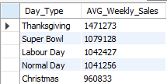
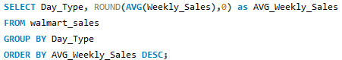
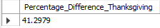
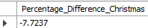
Data Analysis
Impact of Special Events (Holidays) on Weekly Sales
Q: What is the average weekly sales per type of special event?
A: Thanksgiving holiday weeks generate the biggest revenue, on average 41% higher than normal weeks, while Christmas generates approximately -8% compared to normal weeks.

Slide 14
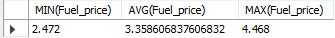
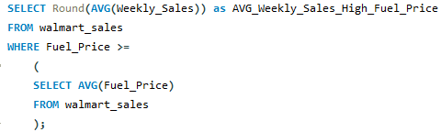
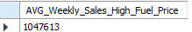
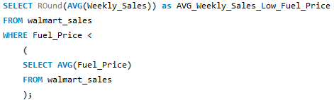
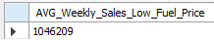
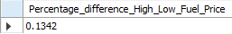
Data Analysis
Impact of Fuel Price on Weekly Sales
Q: What is the behaviour of the weekly sales when fuel price is above or below average?
A: Weekly sales don’t seem to be correlated to fuel prices, since the average weekly sales when fuel prices are above average is mostly unchanged (0.1% higher with higher fuel prices) compared to when fuel prices are low.

Slide 15
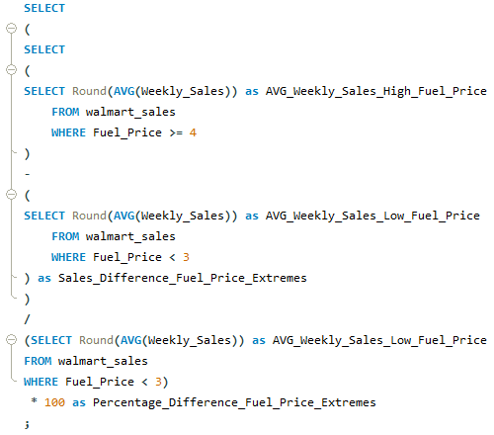
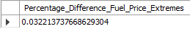
Data Analysis
Impact of Fuel Price on Weekly Sales
Q: What happens to the weekly sales behaviour if fuel prices fluctuate around the extremes (less than 3, more than 4)?
A: Even with fuel prices fluctuating around the extremes, there seems to be no correlation with the weekly sales from Walmart, given the sales remained unchanged (0.03%) when fuel prices were higher.

Slide 16
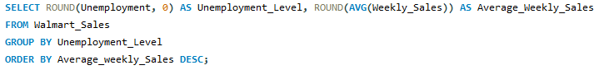
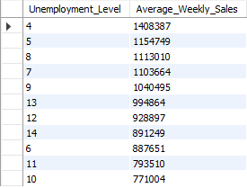
Data Analysis
Impact of Unemployment on Weekly Sales
Q: How does weekly sales behaviour change with different levels of unemployment?
A: Weekly sales seem to be correlated to the level of unemployment, given how the low levels of unemployment (4,5,7,8) are in the top4 highest average weekly sales.

Slide 17
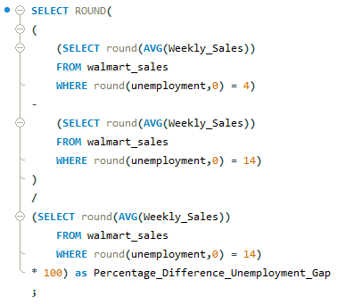
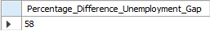
Data Analysis
Impact of Unemployment on weekly sales
Q: How much is the difference on the weekly sales given the highest and lowest levels of unemployment?
A: The difference on average weekly sales with 14% unemployment compared to 4% is 58%, which seems to indicate the level of unemployment is a strong factor affecting Walmart sales.

Slide 18
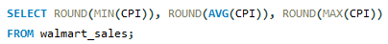
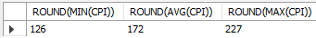
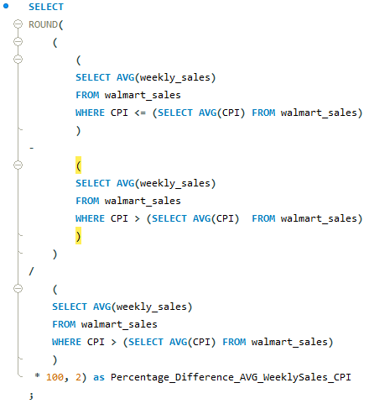
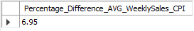
Data Analysis
Impact of CPI on weekly sales
Q: How does weekly sales behave when CPI is above or below average?
A: On average, weekly sales are higher approximately 7% when CPI is below average, compared to when it’s above average.
This suggests a mild negative correlation between average weekly sales and CPI.

Slide 19
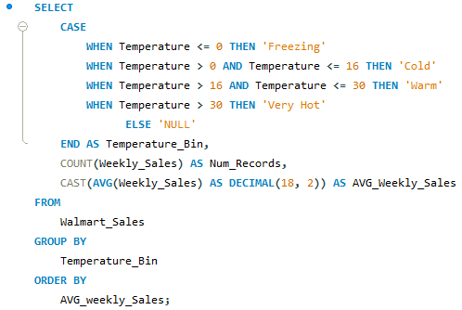
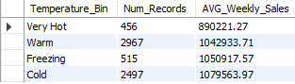
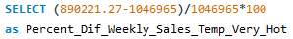
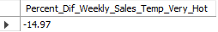
Data Analysis
Impact of Temperature on weekly sales
Q: How does weekly sales behave with temperature changes?
A: Weekly sales seem to not change much with temperature, except when it’s very hot. When it’s very hot, sales were approx. 15% lower than average.

Slide 20
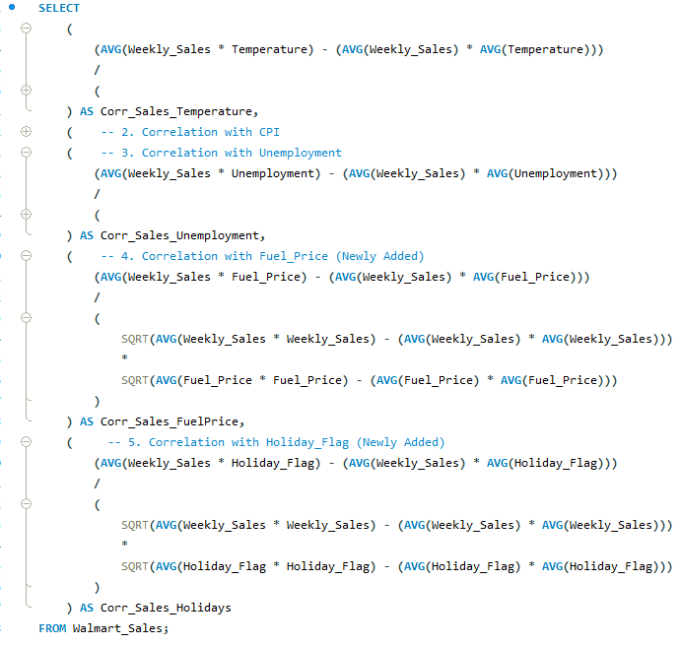
Data Analysis
Pearson Correlation between Weekly Sales and the different factors
Our main insights about the impact of the different factors on weekly sales seem to be consistent with the Pearson Correlations.
Temperature, CPI, Fuel Price and Holidays in general don’t seem to be significantly correlated with weekly sales.
Unemployment on the other hand, does seem to have a meaningful negative correlation with weekly sales.

Slide 21


Thank you for your attention!
Click the arrow to revisit Insights & Recommendations

